Slide 1
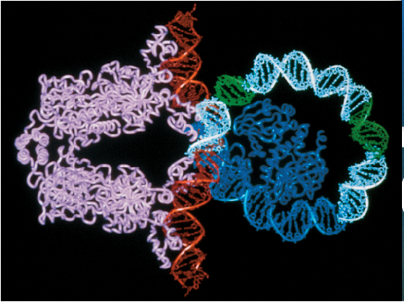

Chapter 6
Genetic Analysis in Prokaryotes
Jian Lu
CHAPTER OUTLINE
15.1 Overview of Prokaryotic Gene Regulation
15.2 The Regulation of Gene Transcription
15.3 Attenuation of Gene Expression: Termination of Transcription
15.4 Global Regulatory Mechanisms
15.5 A Comprehensive Example: The Regulation of Virulence Genes in V. cholerae

Slide 2
Fundamental question in Genetics
Gene structure
Gene transmission to next generation
Gene replication and variation
Gene expression and function
Gene interaction

Slide 3
Properties of cells are mainly determined by differential expression of genes
Spatial and temporal expression patterns
Expression levels
Types and numbers of RNA molecules
Cell identity,
function and properties of cells
Types and numbers of protein molecules

Slide 4
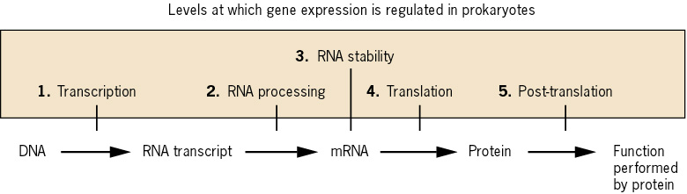
Gene regulation occurs in any stage of gene transcription and translation.
An abbreviated pathway of gene expression, showing five important levels of regulation.

Slide 5
Expression of genes is affected by many factors
Regulation of gene expression includes changes in activating, increasing, diminishing, and preventing the transcription and translation of genes.
In prokaryotes, nutritional condition and environmental factors are important factors to regulate gene expression.
In eukaryotes, hormones, developmental stages and tissue specificity are important factors to regulate gene expression.

Slide 6
RNA polymerase participates in all three phases of transcription
DNA is separated into
RNA-like strand and
template strand

Slide 7
RNA polymerase participates in all three phases of transcription
Initiation – core RNA polymerase plus sigma (σ) factor
Core has four subunits: two alpha (α), one beta (β), one beta prime (β')
DNA is unwound and polymerization begins
Elongation – core RNA polymerase without σ factor
Continues until RNA polymerase recognizes termination signal
Termination – two kinds in bacteria
Rho-dependent – Rho (ρ) protein binds to RNA polymerase and removes it from RNA
Rho-independent – 20 nt sequence in RNA forms stem-loop

Slide 8
Core RNA polymerase and sigma (σ) factor form a holoenzyme to initiate transcription
catalysis
binds DNA
assemble the enzyme
Core RNA polymerase has five subunits: two alpha (α), one beta (β), one beta prime (β'), and ω.
Sigma factor recognize the DNA sequence at the promoter region
3. DNA is unwound and polymerization begins
The initiation of transcription is completed when sigma factor is
released.

Slide 9
Sigma (σ) factor recognizes conserved DNA motifs(from -35 to -10) in the promoter regions
All promoters in E. coli share two different short stretches of nucleotides (yellow) that are essential for recognition of the promoter by sigma factor

Slide 10
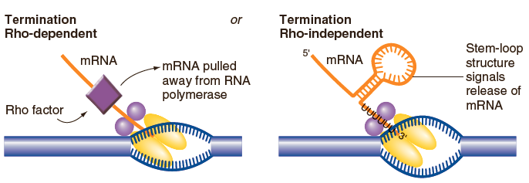
Two kinds of transcription termination in bacteria
When Rho protein recognize a sequence of mRNA and pull mRNA away from RNA polymerase
A stem-loop structure forms in mRNA and cause the release of mRNA and RNA polymerase

Slide 11
Regulation of expression can occur at many steps
Transcriptional control
Binding of RNA polymerase to promoter. This is the most critical step in regulation of most prokaryotic genes.
Shift from initiation to elongation
Release of mRNA at termination
Posttranscriptional control
Stability of mRNA
Efficiency of translation initiation
Stability of polypeptide

Slide 12
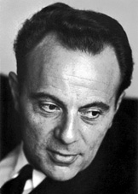
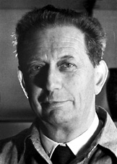
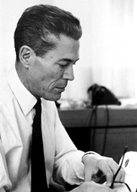
The Nobel Prize in Physiology and Medicine 1965
François Jacob André Lwoff Jacques Monod
"for their discoveries concerning genetic control of enzyme and virus synthesis".
Jacob and Monod originated the idea that control of enzyme levels in all cells occurs through regulation of transcription.

Slide 13
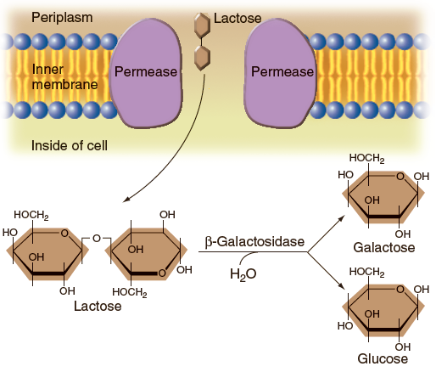
Utilization of lactose by E. coli provides a model system of gene regulation
Proliferating E. coli can use any one of several sugars as a source of carbon and energy. They can use lactose by requiring two enzymes.
Permease transports lactose into cell
β-Galactosidase (β-Gal) converts lactose into glucose and galactose

Slide 14
Lactose is the inducer of the genes encoding permease and β-Gal
Without lactose, both permease and β-gal are present at very low levels in the cell
Lactose induces a 1000-fold increase in β-gal activity
Induction – stimulation of synthesis of a specific protein
Inducer – molecule responsible for induction

Slide 15
Studies of lac⁻ mutants revealed the operon theory of gene regulation
Jacques Monod and Francois Jacob – Pasteur Institute
Identified mutants on induction and repression of enzyme activity for lactose utilization
Operon theory - one signal can simultaneously regulate expression of several clustered genes
Hypothesized that lac genes are transcribed together as a single mRNA (polycistron) from a single promoter

Slide 16
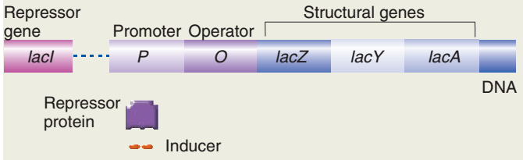
The lactose operon in E. coli
Key players
Three structural genes - lacZ, lacY, and lacA
Promoter – DNA sequences to which RNA polymerase binds
Operator – DNA sequences controls transcription initiation
Repressor - binds to the operator (encoded by lacI gene)
Inducer - prevents repressor from binding to operator, in this model lactose is the inducer.
lacZ: encode β-gal
lacY: encode Permease

Slide 17
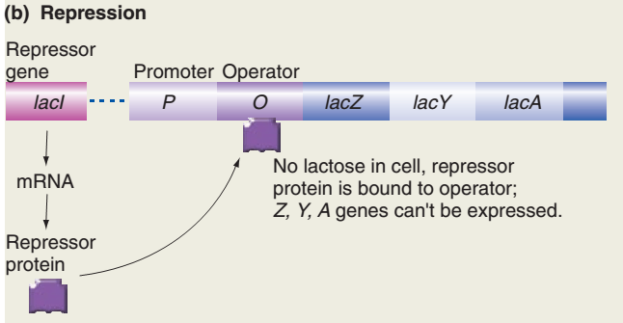
Repression of lac gene expression
In the absence of lactose, lacI binds to the operator and prevents transcription
lacI is a negative regulatory element
lacZ: encode β-gal
lacY: encode Permease
Fig. 15.2b

Slide 18
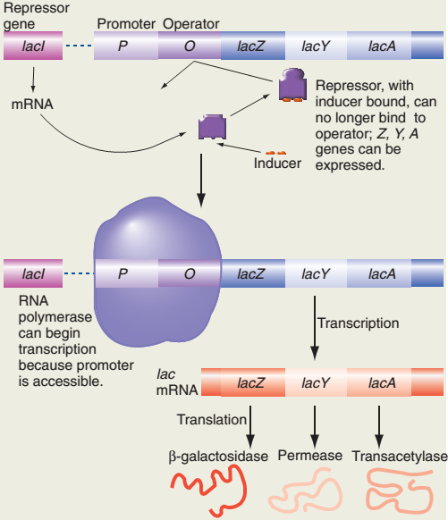
Induction of the lac operon in E. coli
When lactose is present:
1. lactose binds to the lacI protein
2. lacI protein changes shape and cannot bind to operator
3. RNA polymerase binds to the promoter because promoter regions is accessible.
4. Transcription of the lac genes is initiated
lactose

Slide 19
Jacob and Monod defined the roles of the lac genes by genetic analysis of many lac mutants
Complementation analysis identified three genes in a tightly linked cluster
lacZ encodes β-gal
lacY encodes permease
lacA encodes transacetylase
Most studies focused on lacZ and lacY
Continuous expression of β-gal and permease was caused by mutations in the lacI gene
Constitutive mutants (lacI⁻) express the enzymes in the absence and presence of inducer

Slide 20
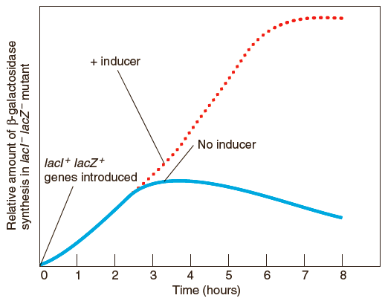
The PaJaMo experiment provided evidence that lacI encodes a repressor
lacI⁺ lacZ⁺ DNA transferred into lacI⁻ lacZ⁻ cells
β-gal levels increased initially
β-gal levels decreased as repressor accumulated
β-gal accumulation resumed after addition of lactose
Fig. 15.7
Jacob and Monod proposed that lacI encodes a repressor that binds to an operator site near the lac promoter

Slide 21
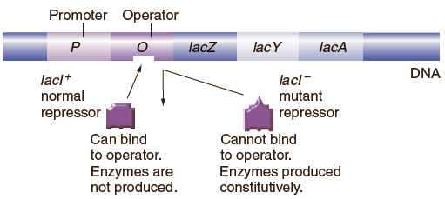
lacl⁻ mutant that cannot bind to operator
In lacI⁻ mutants, lac genes are expressed in the absence and the presence of inducer (continuous expression)

Slide 22
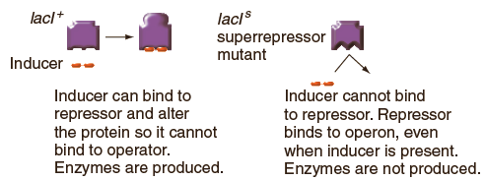
lacl^{s} mutants have a super-repressor that binds to operator but cannot bind to the inducer
In lacI^{S} mutants, lac genes are repressed in the absence and the presence of lactose

Slide 23
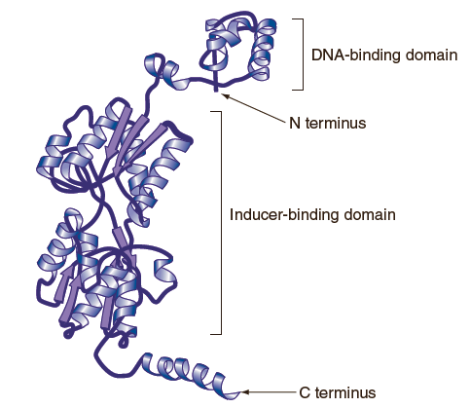
lacI has two separate domains
N-terminal DNA-binding domain, which binds operator sequence
Inducer-binding domain, which binds allolactose, an derivative of lactose
A linker that connects the DNA-binding domain with the core domain, which is important for allosteric communication
Mutated sequences in many different lacI⁻ mutants clustered in the DNA-binding domain, cause constitutive expression
Mutated sequences in many different lacI^{S} mutants clustered in the inducer-binding domain, cause super-repression
Fig. 15.10

Slide 24
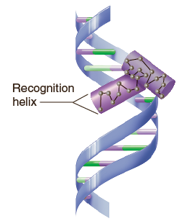
The DNA binding domain of lacI has a helix-turn-helix (HTH) motif to recognize DNA sequences
A protein with an HTH motif has two α-helical regions separated by a turn in the protein
The HTH motif fits into the major groove of DNA
One of the α-helices recognizes a specific DNA sequence
Fig. 15.18

Slide 25
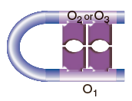
lac repressor tetramer binds to two operators
1. laci is a tetramer, with each subunit containing a DNA-binding HTH motif
2. lac operon has three operators (O₁, O₂, and O₃) each of which contains two recognition sequences for lac repressor. O₁ has the strongest binding affinity for lac repressor
3. Two repressor subunits bind to O₁ and two repressor subunits bind to either O₂ or O₃
4. This binding pattern allows
tetrameric lacI to induce
DNA looping
Fig. 15.2

Slide 26
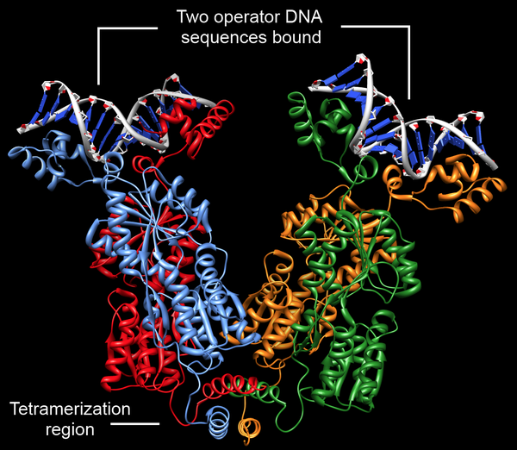
Tetrameric lacI binds two operators and induces DNA looping

Slide 27
Allosteric protein – undergoes reversible changes in conformation when bound to another molecule
Binding of inducer (effector) to activator or repressor changes the shape of the activator or repressor.
lacI is an allosteric protein
When no effector is present, activator does not bind to DNA; when bound effector, activator binds to DNA
When no effector is present, repressor binds to DNA;when bound effector, repressor no longer binds to DNA

Slide 28
The operator are specific DNA sequences recognized by lacI
Each operator of lac operon have two DNA sequence motifs.

Slide 29
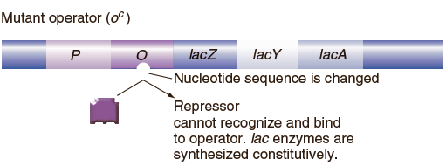
lacO^{c} mutants have a mutant operator that cannot bind the repressor
In lacO^{c} mutants, lac genes are expressed in the absence and the presence of inducer (constitutive expression)

Slide 30
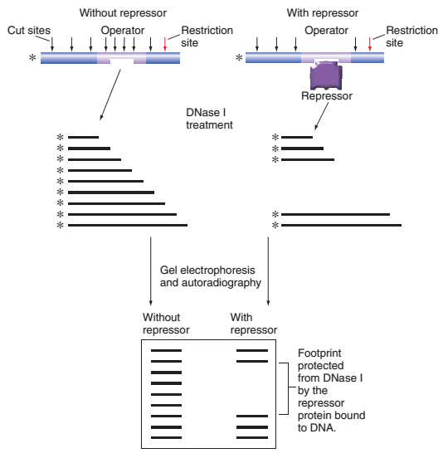
DNase footprint detects the binding of laci and operator DNA
Incubate radiolabeled DNA from lac⁺ operon with partially purified protein from lacI⁺ cells
Partial digest of DNA with DNase I
Gel electrophoresis and autoradiography
If protein is bound to DNA, then specific fragments will be protected from DNase digestion
Fig. 15.20

Slide 31
Proteins act in trans, DNA sites act in cis
Jacob and Monod used partial diploids carrying different alleles of lac regulatory elements and structural genes to identify trans-acting and cis-acting elements
F' lac plasmids were used to generate partial diploids
Trans-acting factor: lacI
Can diffuse through the cytoplasm and act at target DNA sites on any DNA molecule in the cell
Cis-acting elements: lacO
Can only influence expression of adjacent genes on the same DNA molecule

Slide 32
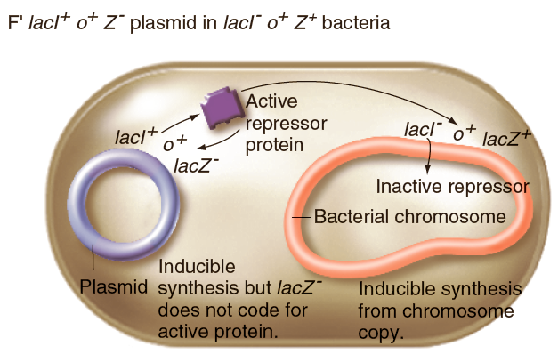
Lacl⁺ protein acts in trans
Repressor expressed from the plasmid can diffuse through the cytoplasm and bind to the operator on the chromosome

Slide 33
Lacl⁺ protein acts in trans
lacI expressed from the plasmid can diffuse through the cytoplasm and bind to the operator on the chromosome

Slide 34
DNA sequence mutations in lacO acts in cis
The lacO^{C} mutation affects expression of genes only on the DNA that it is located on

Slide 35
The lac operon of E. coli is regulated by both lactose and glucose
1. When both glucose and lactose are present, only glucose is utilized
2. Lactose induces lac mRNA expression, but only in the absence of glucose
Lactose prevents repressor from binding to lacO
lac repressor is a negative regulator of lac transcription
3. lac mRNA expression cannot be induced if glucose is present
Glucose decreases the levels of cAMP
cAMP binds to cAMP receptor protein (CRP)
CRP-cAMP is a positive regulator of lac transcription

Slide 36
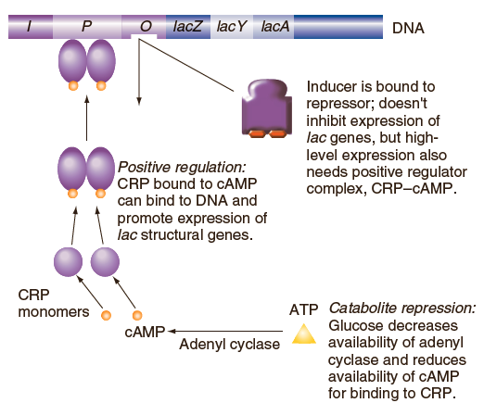
Positive regulation of lac operon by CRP–cAMP
腺苷酸环化酶
Fig. 15.15

Slide 37
Glucose negatively regulate cAMP
ATP
cAMP
cAMP-CRP
Catabolite repression – overall effect of glucose is to prevent lac gene expression
CRP
CRP
CRP

Slide 38
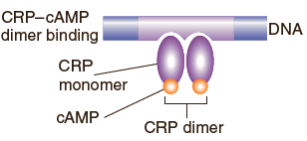
CRP–cAMP binds as a dimer to a regulatory region
CRP-binding sites have a two-fold rotational symmetry
CRP protein binds as a dimer
CRP-binding site consists of two recognition sequences, one for each subunit of the CRP dimer
5'TGTGAGTTAGCTCACA 3'
3'ACACTCAATCGAGTGT 5'
Fig. 15.21

Slide 39
Negative and positive control of the lac operon

Slide 40
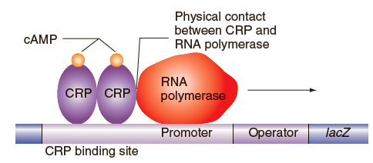
CRP-cAMP complex makes direct contact with RNA polymerase
Without interaction with CRP-cAMP, RNA polymerase can bind to the promoter but is less likely to unwind DNA and initiate transcription
Fig. 15.25

Slide 41
Negative and positive control of the lac operon
Many negative regulators (e.g. lac repressor) prevent transcription initiation by blocking the functional binding of RNA polymerase
Many positive regulators (e.g. CRP-cAMP) establish contact with RNA polymerase that enhances transcription initiation

Slide 42
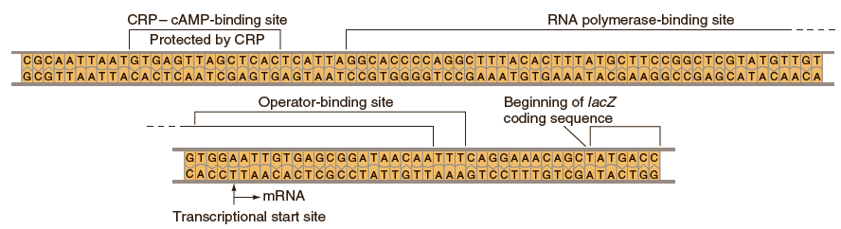
Overlapping binding sites for RNA polymerase and lac repressor
When lac repressor is bound to lac operator, functional binding of RNA polymerase to the promoter is blocked
Fig. 15.24

Slide 43
Advantages of using lactose utilization by E. coli as a model for understanding gene regulation
Lac⁻ mutants can be maintained on media with glucose and so lac genes are not essential for survival
If both glucose and lactose are present, E. coli cells will use glucose first
Simple assays for lac expression - use of ONPG or X-gal as substrates for β-gal (color change)
Detection and characterization of hundreds of lac⁻ mutants defective in lactose utilization

Slide 44
lacZ gene is commonly used as a reporter of gene expression
Reporter gene – protein-encoding gene whose expression in the cell is quantifiable by sensitive and reliable techniques
Measuring gene expression
Fuse coding region of lacZ to cis-acting regulatory regions from other genes
Identifying sets of genes regulated by the same stimulus
Create library of cells with promoter-less lacZ inserted by transposition into random sites in the genome
Controlling gene expression
Fuse the lac regulatory sequences to the coding region of a foreign gene
Inducible expression of the foreign gene controlled by IPTG

Slide 45
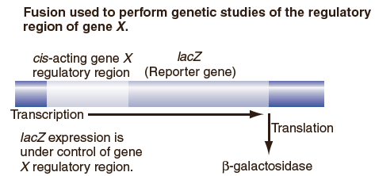
lacZ fusion used to perform genetic studies of the regulatory region of gene X
Conditions that regulate expression of the test regions from gene X will alter the levels of β-galactosidase
Specific regulatory sites can be identified by constructing and testing mutations in the test regions of gene X
Fig. 15.26

Slide 46
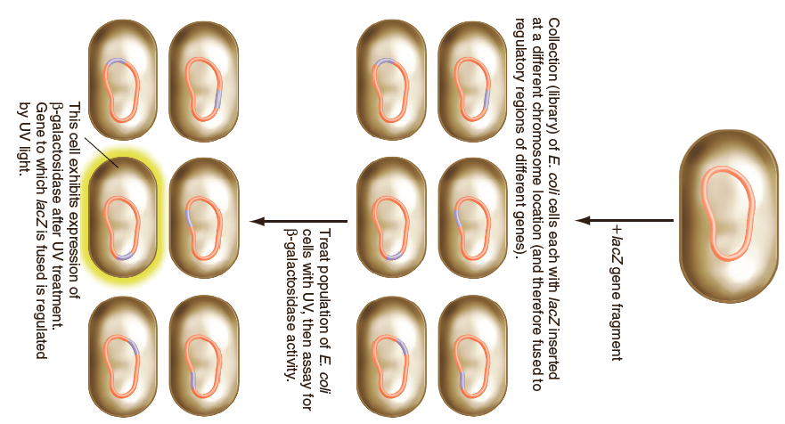
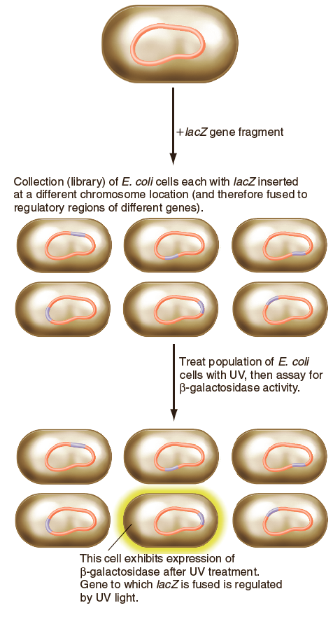
Using lacZ to identify sets of genes regulated by the same stimulus
Fig. 15.27
Transposition of promoter-less lacZ coding region
Library of clones containing lacZ insertions at random sites
Screen library to identify all the genes that express lacZ in response to a signal

Slide 47
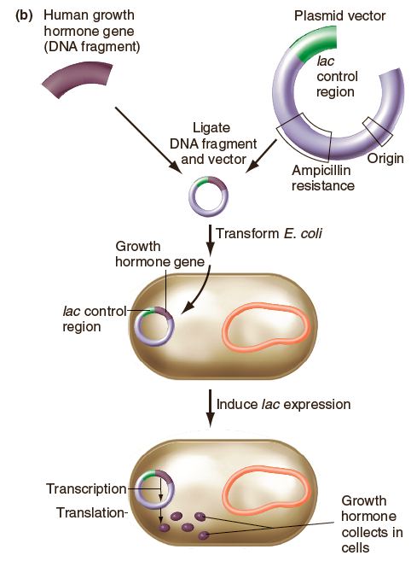
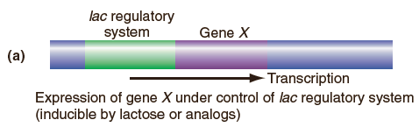
Use of fusions to overproduce a gene product
Expression of gene X under control of the lac regulatory system
Fig. 15.28a
Expression of human growth hormone in E. coli controlled by lac control region
Fig. 15.28b

Slide 48
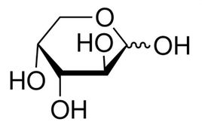
Dual Positive and negative regulation of the araBAD operon by AraC
The control of transcription in bacteria is neither purely positive nor purely negative; rather, both positive and negative regulation may govern individual operons.
Arabinose genes are in an operon and are induced when arabinose is present
Three structural genes required in the breakdown of the sugar arabinose(果胶糖) - araB, araA, and araD
AraC is a either a positive or negative regulator of the araBAD operon
arabinose(果胶糖)

Slide 49
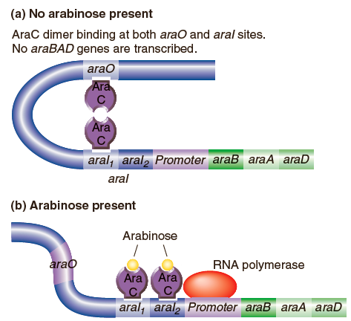
AraC acts as both a repressor and an activator
AraC can bind to three DNA sequences sites (araO, araI₁, and araI₂) with different affinities
(a) No arabinose present:
When AraC is bound to araO and to araI₁, looping of DNA occurs and prevents transcription
(b) Arabinose present:
Arabinose causes allosteric change in AraC so that it cannot bind to araO
AraC interacts with RNA polymerase only when both araI₁ and araI₂ are occupied
Fig. 15.23

Slide 50
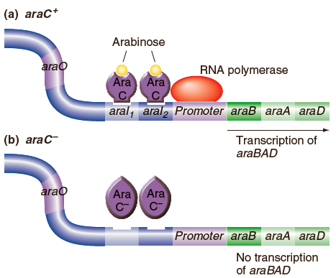
In the mutant of araC, no araBAD is transcribed
Fig. 15.16

Slide 51
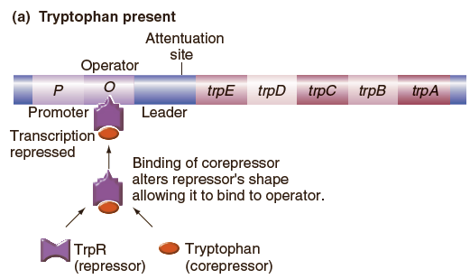
Regulation of the tryptophan (trp) operon in E. coli
Tryptophan operon has five structural genes: trpA, B, C, D and E
Structural genes for tryptophan (Trp) biosynthesis are expressed only in the absence of Trp
TrpR is the repressor

Slide 52
Tryptophan acts as a co-repressor
TrpR gene encodes the trp repressor that can bind to the Trp operator (TrpO)
When Trp is present, binding of tryptophan to TrpR repressor allows TrpR to bind to TrpO and inhibit transcription of the five structural genes
When Trp is absent, TrpR repressor cannot bind to TrpO

Slide 53
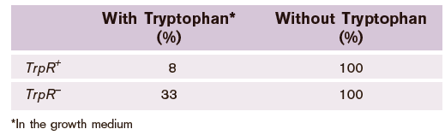
Evidence that TrpR repressor is not the only regulator of the trp operon
1. Constitutive expression of tryptophan biosynthesis doesn't occur in TrpR⁻ mutants
2. Second regulatory mechanism is attenuation – control of gene expression by premature termination of transcription
Expression level of trp operon

Slide 54
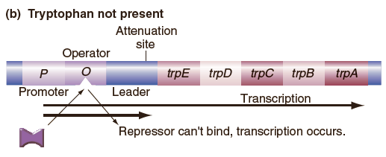
Transcription from the trp promoter produces two alternative mRNAs
Attenuation controls termination of transcription in the trp leader (TrpL)
Truncated mRNA - terminates in TrpL, only 140 bases
Full-length mRNA - continues through TrpL and encodes all five structural genes

Slide 55
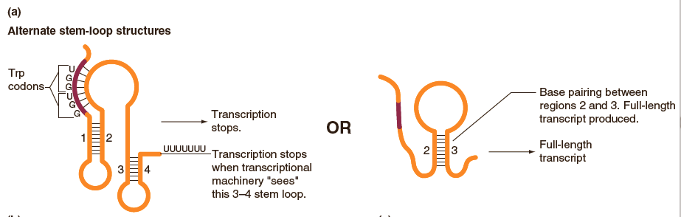
Alternate stem-loop structures in trpL RNA
Different regions of trpL have complementary base-pairing
Formation of the 1-2 stem-loop allows formation of the 3-4 stem-loop
Formation of the 2-3 stem-loop prevents formation of the 3-4 stem-loop
The 3-4 stem loop is a transcription terminator
Fig. 15.30a

Slide 56
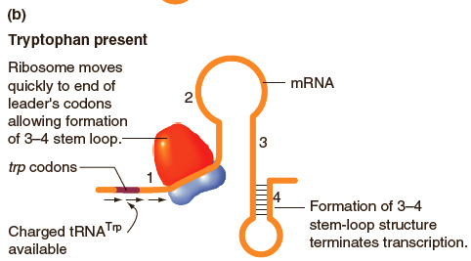
When tryptophan is present, transcription terminates in trpL because of translation
The trpL mRNA is translated and includes two trp codons
Movement of ribosomes through trpL mRNA depends on the availability of tRNA^{Trp}
When Trp is present, tRNA^{Trp} is available and rapid ribosome movement allows the formation of 3-4 stem-loop
Fig. 15.30b

Slide 57
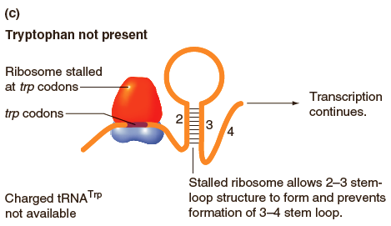
When tryptophan isn't present, transcription doesn't terminate in trpL
Fig. 15.30c

Slide 58
Two mechanisms for trp operon regulation
TrpR gene encodes the trp repressor that can bind to the Trp operator (TrpO)
When Trp is present, TrpR repressor binds to TrpO
When Trp is absent, TrpR repressor cannot bind to TrpO
Attenuation controls termination of transcription in the trp leader (TrpL)
When Trp is present, transcription terminates in TrpL
When Trp is absent, transcription doesn't terminate in TrpL

Slide 59
Key Words
positive regulation, positive control(正调控)
negative regulation, negative control(负调控)
cis-acting（顺式作用）
trans-acting（反式作用）
cis-acting element（顺式作用元件）
trans-acting factor（反式作用因子）
induction（诱导）
repression(阻遏)
activator（激活蛋白）
repressor（阻遏蛋白，阻遏物）
effector（效应物）
inducer（诱导物）
corepressor（辅阻遏物，协阻遏物）

Slide 60
Key Words
regulatory gene（调节基因）
operon（操纵子）
promoter（启动子）
operator（操纵基因）
structural gene（结构基因）
cis-dominant（顺式显性）
catabolite repression（分解物阻遏）
catabolite activator protein
（分解物激活蛋白，简称CAP）
cAMP receptor protein
（cAMP受体蛋白，简称CRP）

